Slide 1
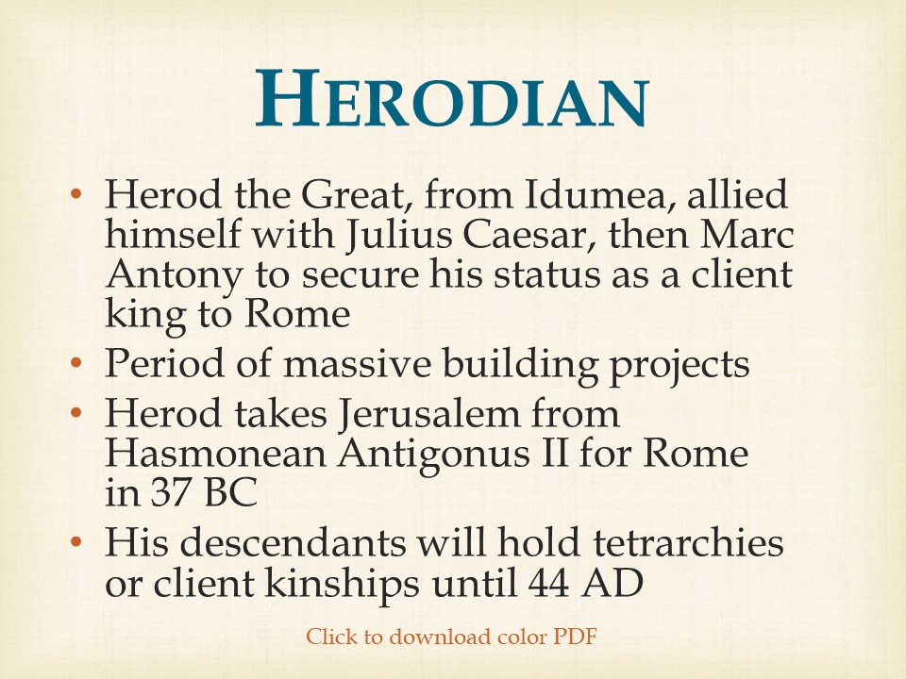

Slide 2
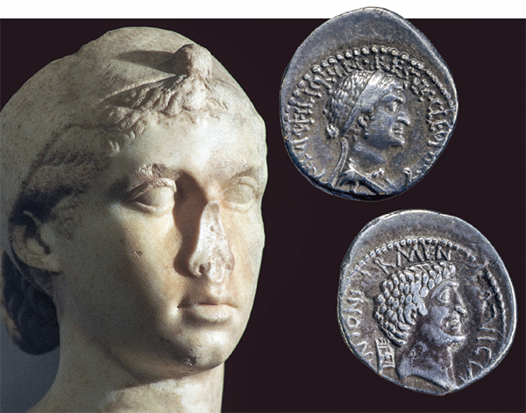
Mark Antony and Cleopatra
Renowned for her beauty, intelligence and cunning, Cleopatra VII was the last ruling pharaoh of the Ptolemaic Dynasty in Egypt. She secured her throne by aligning herself with two of the most powerful men in the Roman world: Julius Caesar and, later, Marc Antony.
Biblical Archaeology Review 41:6, November/December 2015
Coptic: Egypt’s Christian Language
The upper left bust from the Vatican Museum and upper right silver denarius from the collection of the British Museum are some of the few representations of the famous Egyptian queen to have survived from her lifetime. The bust was sculpted between 50 and 30 B.C.E. Minted in 32 B.C.E., the coin depicts Cleopatra on one side (top) and Marc Antony on the other (bottom).

Slide 3
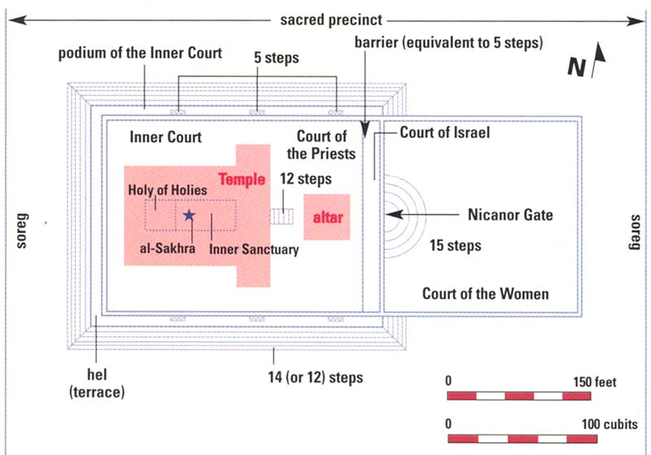
Herod’s Temple
Biblical Archaeology Review 25:5, September/October 1999
Sacred Geometry: Unlocking the Secret of the Temple Mount, Part 2

Slide 4
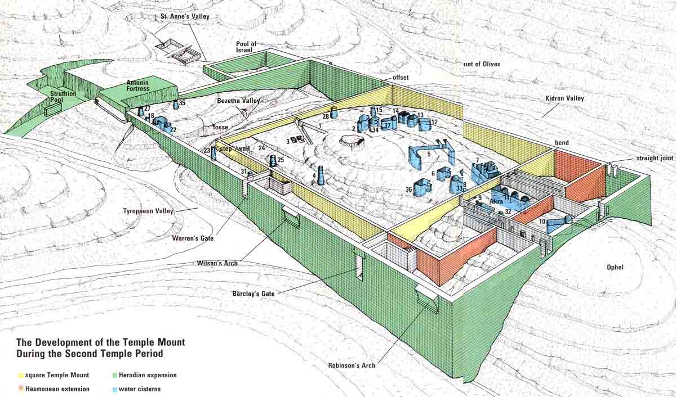
Temple Mount in the Second Temple Period
Biblical Archaeology Review 18:2, March/April 1992
Locating the Original Temple Mount

Slide 5
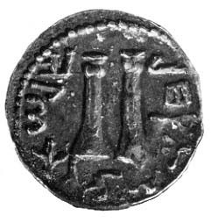
The Place of the Trumpeting
This silver coin, struck during Bar Kochba’s revolt against Rome, 132–135 A.D., shows a pair of trumpets. Such trumpets were traditionally made of silver. A number of coins of this period bear symbols commemorating the music of the Temple, destroyed more than 60 years earlier.
Biblical Archaeology Review 8:1, January/February 1982
The Finds That Could Not Be

Slide 6
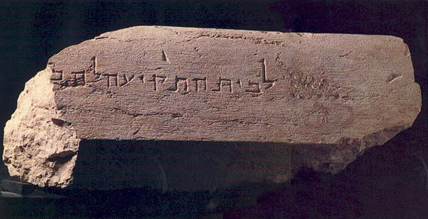
The Place of the Trumpeting
Author Aaron Demsky suggests the complete inscription: “To the place of trumpeting to distinguish between the sacred and the profane,” a phrase known from the Mishnah. Each of these completed statements tells us that very likely there was a special place atop the Temple Mount walls where a priest would stand and blow a trumpet to announce the beginning and the end of each Sabbath.
“To the place of trumpeting to … ” Broken off mid-word, this Hebrew inscription appears on an eight-foot-long stone that probably marked the pinnacle of the Temple Mount’s southwest tower.
Biblical Archaeology Review 12:6, November/December 1986
When the Priests Trumpeted the Onset of the Sabbath

Slide 7
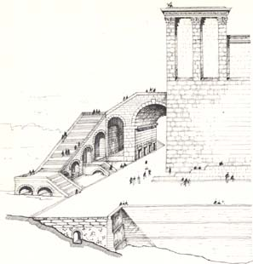
The Place of the Trumpeting
The tiny figure of a priest standing on the tower at the Temple Mount’s southwest corner recreates a scene of Herodian Jerusalem on Friday or Saturday evening. With a shrill trumpet blast, the priest announces to the people in their homes across the valley the beginning (or end) of another Sabbath.
Biblical Archaeology Review 12:6, November/December 1986
When the Priests Trumpeted the Onset of the Sabbath
Notes:
‹#›

Slide 8
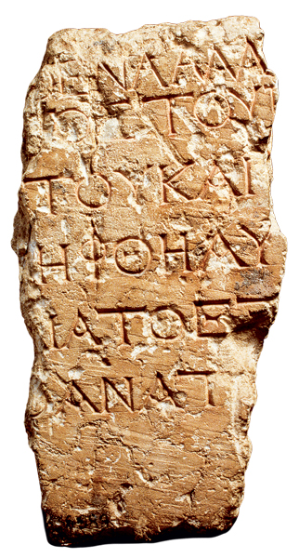
Temple Warning Inscription
Fragment of a sign warning Gentiles not to enter the inner court of the Temple in Greek. Even before the destruction of the Jerusalem Temple in 70 C.E., for example, Greek was commonly used for public inscriptions, such as the signs warning Gentiles not to enter the inner court of the Temple (a fragmentary example found in Jerusalem in 1935 is shown above). Hebrew and Aramaic were used primarily for informal, private inscriptions, such as those that often adorned Jewish burial boxes, or ossuaries.
Biblical Archaeology Review 37:4, July/August 2011
Strata: Inscriptions Show Ancient Jerusalem Was a Global City
Notes:
‹#›

Slide 9
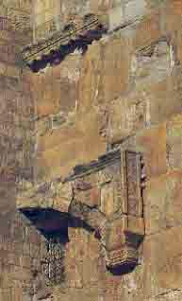
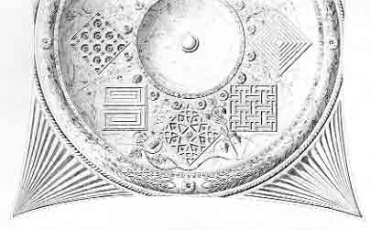
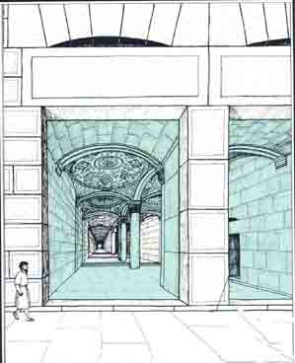
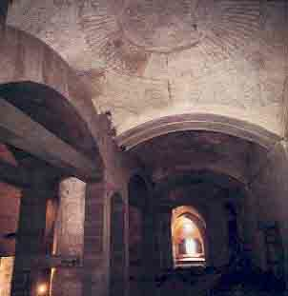
The Entrance on the Southern Wall of Temple Mount Through the Double Gate of Huldah
Biblical Archaeology Review 15:6, November/December 1989
Reconstructing Herod’s Temple Mount in Jerusalem

Slide 10
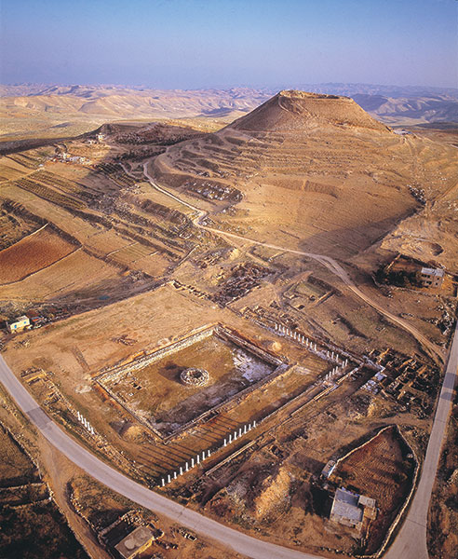
Herodium
The grand estate at Herodium is a testament to Herod’s building prowess. Its construction began in 28–27 B.C.E. after Herod returned from Rome upon securing the support of Augustus and Marc Antony and being appointed king of Judea. The palace-fortress on the summit of the mound was built first and then the vast palace complex—Lower Herodium—at its base. A veritable lap of luxury, Lower Herodium boasted a 1,200-by-100-foot man-made course, a bathhouse with mosaic floors and a large plastered pool with an island in its middle.
Biblical Archaeology Review 40:3, May/June 2014
Was Herod’s Tomb Really Found?

Slide 11
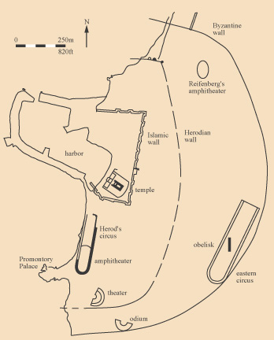
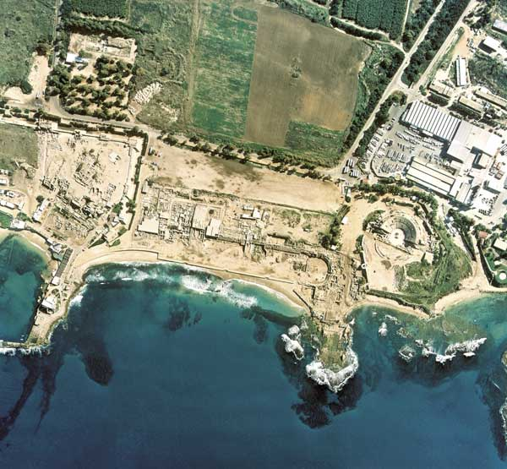
Caesarea Maritima
Herod took 12 years to construct Caesarea Maritima (from 22 B.C.E. to 10/9 B.C.E.).
Biblical Archaeology Review 30:5, September/October 2004
Vegas on the Med

Slide 12
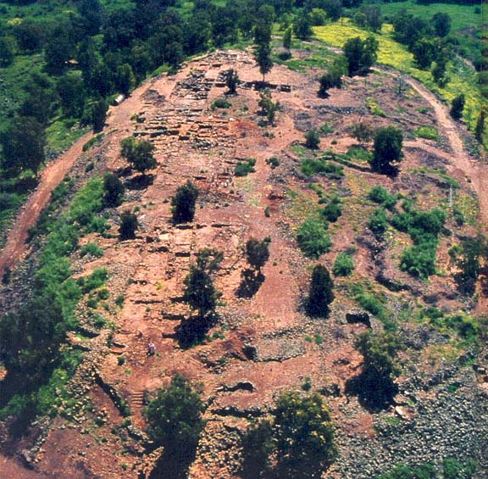
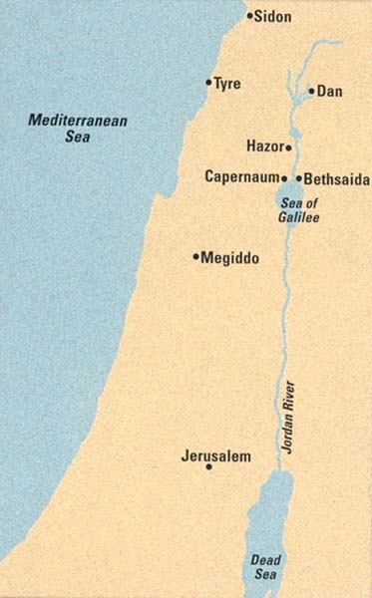
Bethsaida
The Gospel of Luke places the feeding of the five thousand at Bethsaida (Luke 9:12–17). And according to the Gospel of Mark, Jesus cured a blind man at Bethsaida (Mark 8:22–25). Mark also locates one of Jesus’ most famous miracles—his walk on the water—near Bethsaida (Mark 6:45–51).
The Gospel of John records that Bethsaida was the home of the disciples Philip, Andrew and Peter (John 1:44). But Bethsaida was also the target of a withering curse by Jesus: “Then he began to reproach the cities in which most of his deeds of power had been done, because they did not repent. ‘Woe to you, Chorazin! Woe to you, Bethsaida! For if the deeds of power done in you had been done in Tyre and Sidon, they would have repented long ago in sackcloth and ashes’”(Matthew 11:20–23).
Biblical Archaeology Review 26:1, January/February 2000
Bethsaida Rediscovered

Slide 13
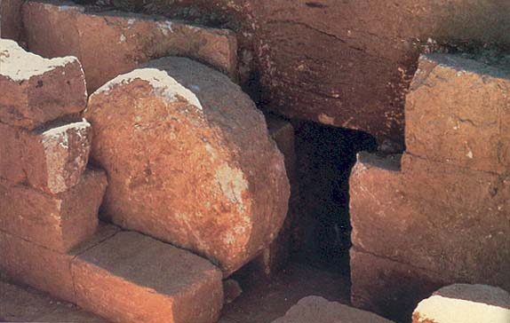
Rolling Stone Tomb Typical of 1st Century Judea
Rolling-stone tomb. Typical of limestone-carved, first-century tombs in Judea and nearby areas, this one from Tell Hesban in Jordan may be very similar to the tomb in which Jesus was buried. The Gospel of Matthew (27:59–60) relates that Joseph of Arimathea wrapped the body of Jesus in a clean linen cloth and laid it in his own new tomb, and “rolled a great stone to the door of the sepulchre.”
In such tombs, the round stone rolled freely along a slanted track or was pushed along a level track in order to cover and seal the entrance to the burial cave. (Shown here is a level track.)
Biblical Archaeology Review 12:4, July/August 1986
New Evidence May Explain Image on Shroud of Turin

Slide 14
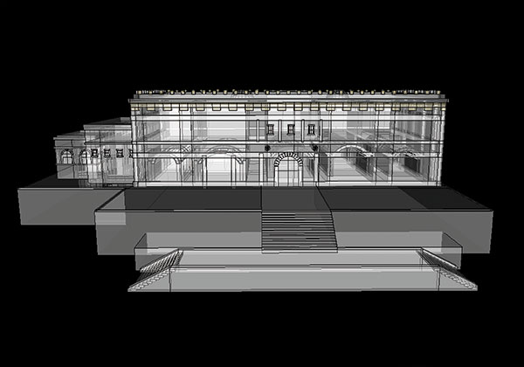
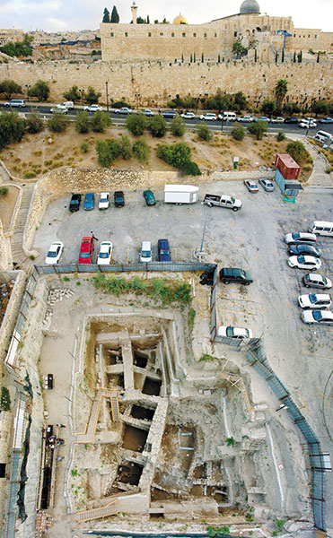
Palace Discovered Underneath a Parking Lot at the City of David
The Israel Antiquities Authority excavation in the Givati Parking Lot has uncovered 12 different occupational strata, including one with a palatial structure from the Second Temple period (reconstructed here by archaeologists Doron Ben-Ami and Yana Tchekhanovets).
The Givati Parking Lot -The site’s spectacular location in the northern part of the City of David is rivaled only by the extraordinary archaeological remains beneath—from the First Temple through Islamic periods. A large structure dated to the end of the Second Temple period (first century C.E.) may well be the palace of Queen Helena of Adiabene.
Biblical Archaeology Review 40:3, May/June 2014
Queen Helena’s Jerusalem Palace—In a Parking Lot?

Slide 15
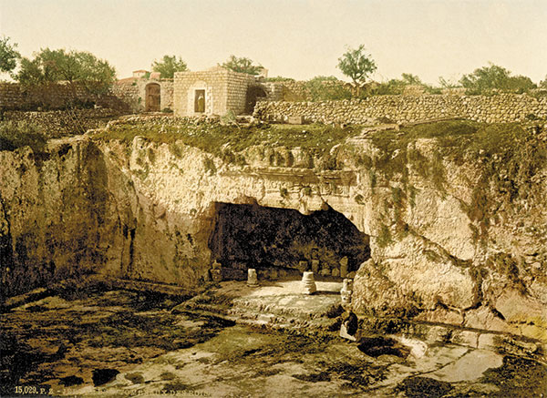
Queen Helena’s Tomb
Seemingly ageless, the Tomb of the Kings—really the tomb of Queen Helena of Adiabene—looks nearly the same today as it did in this photograph from about 1900. Although partially in ruins, its ornate façade hints at the splendor of the tomb in the first century C.E. when it was constructed.
Biblical Archaeology Review 40:3, May/June 2014
Queen Helena’s Jerusalem Palace—In a Parking Lot?

Slide 16
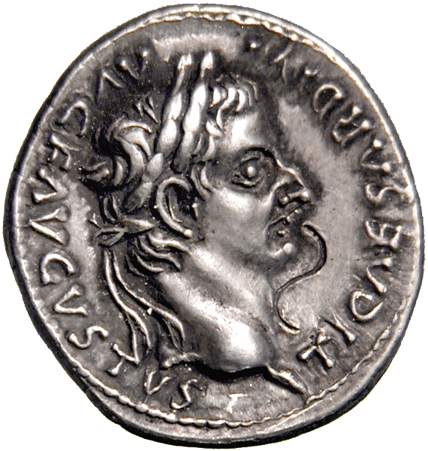
Roman Denarius of Tiberius Caesar
The tribute coin Jesus asks to see when he prepares his rebuttal would have been a silver denarius of the Roman emperor Tiberius (the reigning emperor at the time Jesus preached in Jerusalem). On its front, it bore Tiberius’s head—his eikoµn or “likeness”—and the legend TI CAESAR DIVI AVG F AVGVSTVS, “Tiberius Caesar, son of the Divine Augustus.”
Here is where Jesus delivers his famous answer: “Render therefore to Caesar the things that are Caesar’s, and to God the things that are God’s” (Matthew 22:21; Mark 12:17; Luke 20:25).
Bible Review 19:2, April 2003
What Jesus Really Meant by “Render Unto Caesar”

Slide 17
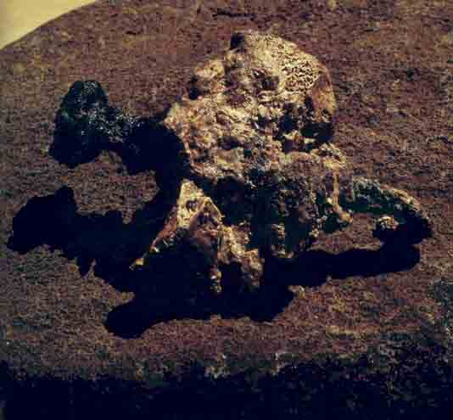
Crucified Heel Bone
Pinned together by a large iron nail, the heel bones of a young man, 24–28 years old, discovered in a tomb near Jerusalem, present dramatic and heart rending evidence of crucifixion. The nail was hammered first into the right foot and then the left; the configuration of the bones indicates the contorted posture the victim had been forced into on the cross
Biblical Archaeology Review 11:1, January/February 1985
Crucifixion—The Archaeological Evidence
Notes:
‹#›

Slide 18
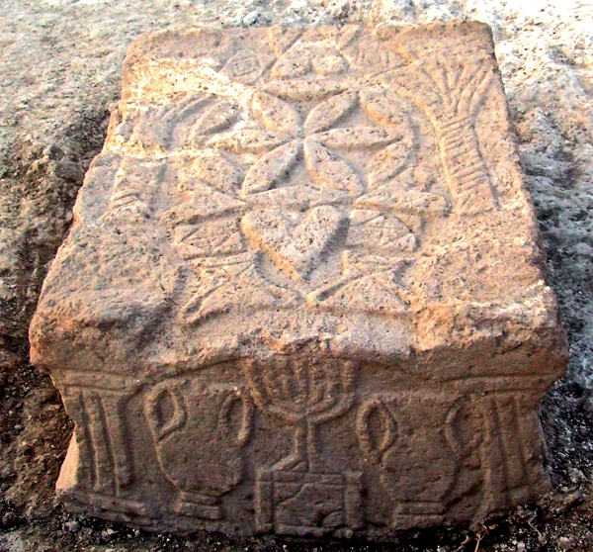
Magdala Synagogue
This roughly 3-foot-long engraved stone with an early depiction of a seven-branched menorah (facing panel) was discovered in the central hall of the Magdala synagogue. The stone may have served as a table on which Torah scrolls were rolled out.
The Magdala synagogue is dated to the first century C.E. or earlier, making it one of the oldest synagogues ever found. It was in use while the Jerusalem Temple still stood. Its halls may have welcomed some of Jesus’ earliest followers, including Mary Magdalene.
Biblical Archaeology Review 37:4, July/August 2011
New Synagogue Excavations In Israel and Beyond

Slide 19
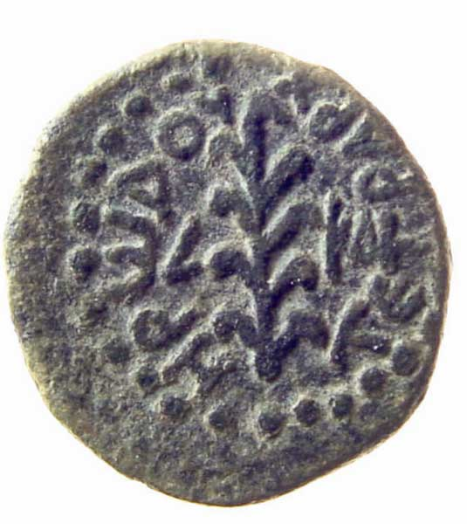
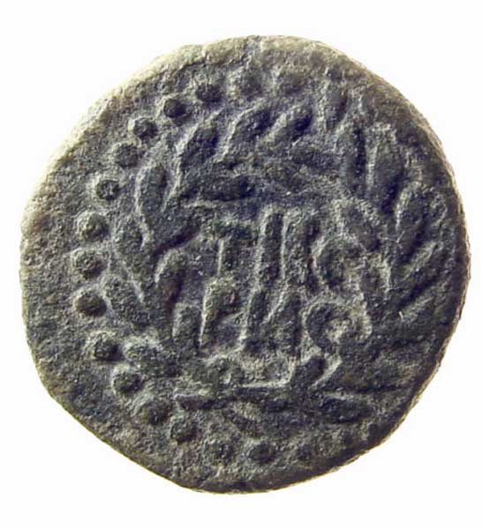
Herod Antipas 4 BC – 39 CE
The coins from the reign of Herod Antipas have Greek inscriptions, but depict no living beings so as not to offend the sensibilities of the Jewish population. The coin shown here was struck during the 24th year of his reign, or 20 C.E. It shows a reed upright with the date on the obverse and an inscription reading “Tiberias” surrounded by a wreath on the reverse.
Biblical Archaeology Review 33:4, July/August 2007
How Jewish Was Jesus’ Galilee?

Slide 20
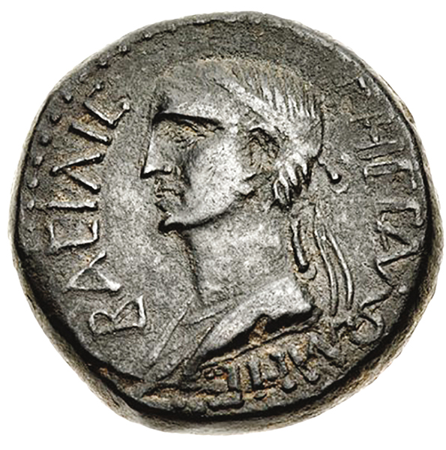
Salome, Famous for Demanding the Head of John the Baptist
The coinage of both Herod the Great and Herod Antipas do not show a portrait of the ruler, keeping in line with the Jewish prohibition against graven images. However, Salome, who danced before Herod Antipas and requested the beheading of John the Baptist, is pictured on this coin; the other side of the coin features her second husband, Aristobulus, King of Chalchis (mostly Gentile).
Biblical Archaeology Review 43:5, September/October 2017
New Testament Political Figures Confirmed

Slide 21
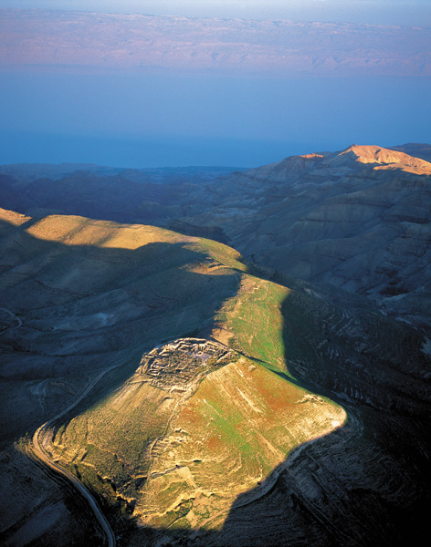
Macherus The end of John the Baptist
Morning sunlight illuminates Machaerus and the Dead Sea. The dramatic mountaintop fortress, perched high above the east coast of the Dead Sea, served as John the Baptist’s prison as well as Herod’s eastern bulwark.
Biblical Archaeology Review 38:5, September/October 2012
Machaerus: Where Salome Danced and John the Baptist Was Beheaded

Slide 22
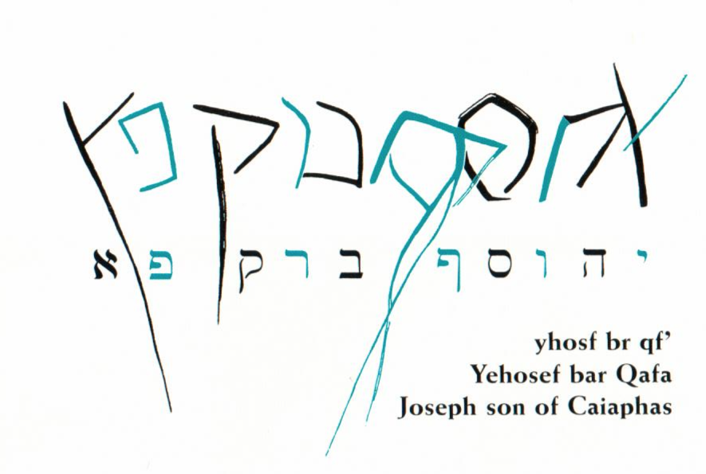
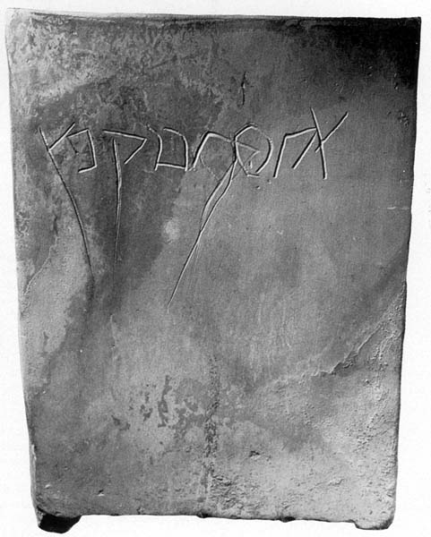
The High Priest Caiaphas 18-36 CE
Though the New Testament calls the high priest who tried Jesus by the single name Caiaphas, the first-century C.E. Jewish historian Josephus refers to a “Joseph who was called Caiaphas of the high priesthood.” Caiaphas is therefore a family name or possibly a nickname.
Biblical Archaeology Review 18:5, September/October 1992
Caiaphas Name Inscribed on Bone Boxes
Notes:
‹#›

